Slide 1
User Interface Refactoring – SCU APS

Slide 2
Our team
Malak Abdelbaki
Sarah El-Feel
Alaa Ashraf
Abdelrahman Samir
Omar Sherif
Abdelrahman Shaker
Mohammad Hossam
Abdelrahman Elnagar

Slide 3
We have 3 stops
01
02
03
Elicitation techniques
Requirements & specifications
As Is - To be Model

Slide 4
We chose the Applicant UI to refactor

Slide 5


01
Elicitatoin Technigues

Slide 6
We conducted two Interviews
Interview with a user of the old software
Interview with a technical lead from the software company Dr. John Zaki

Slide 7
Interview 1
Main issues to address:
Passwords instead of passkey
Payment buttons are not clear
Guide not descriptive
Contact is not easy
No autofill option
Design not user friendly

Slide 8
Interview 2
Main issues to address:
Progress bar for each request state
Important actions in requests page
Separate requests page

Slide 9
User Interface Analysis
We analyzed the old software and annotated the anomalies in the design to be addressed.

Slide 10
02
Requirements & specifications

Slide 11
Documenting the new system by SRS addressing
Purpose of refactoring and objectives
Product Functions and User specification
External Interface Requirements
System FR and NFR

Slide 12
03
As Is To be Model

Slide 13
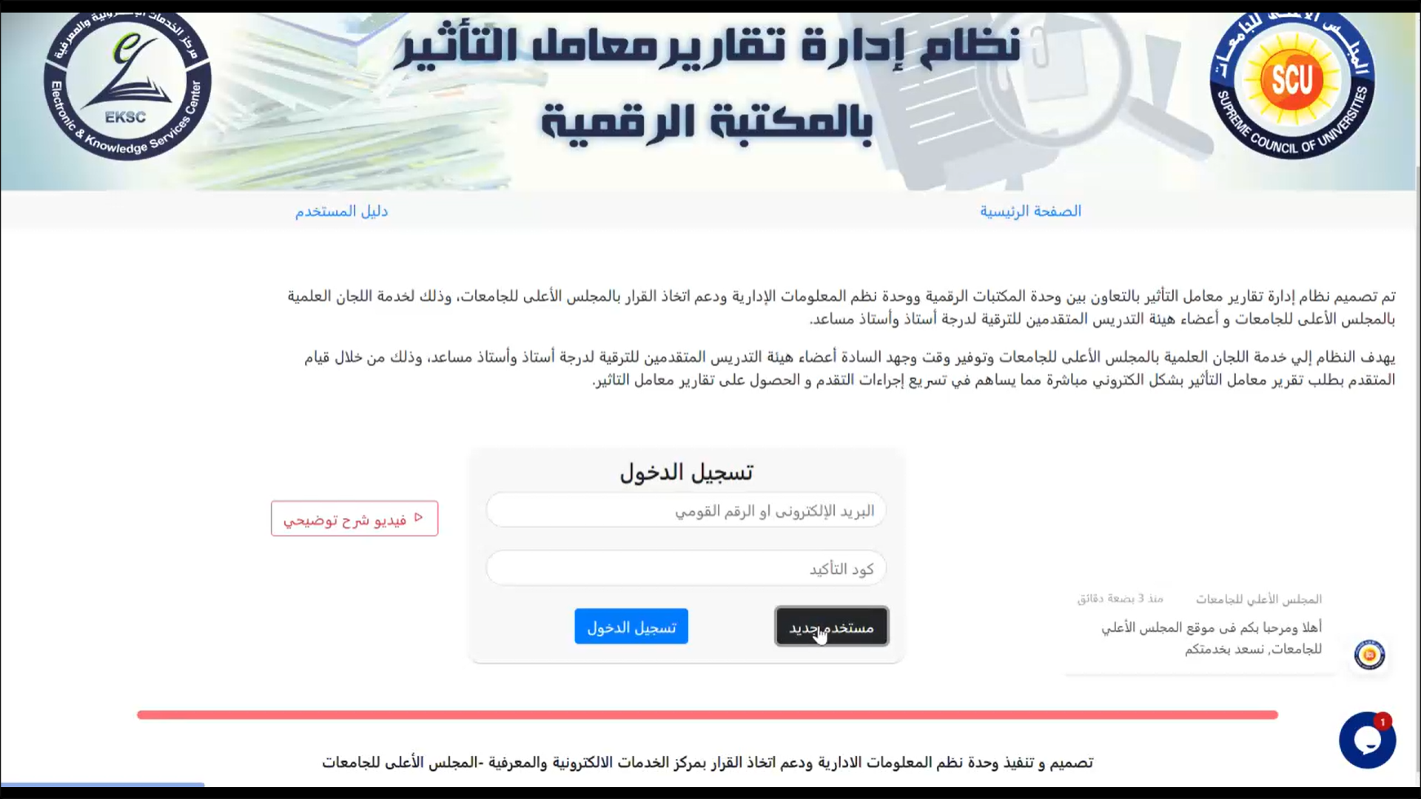
As Is - Login
Bad Header in many terms
No toggle eye
Not clear video bad button design

Slide 14
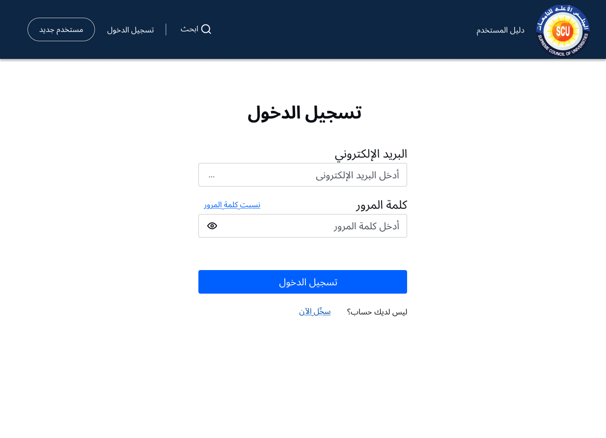
To Be – Login

Slide 15
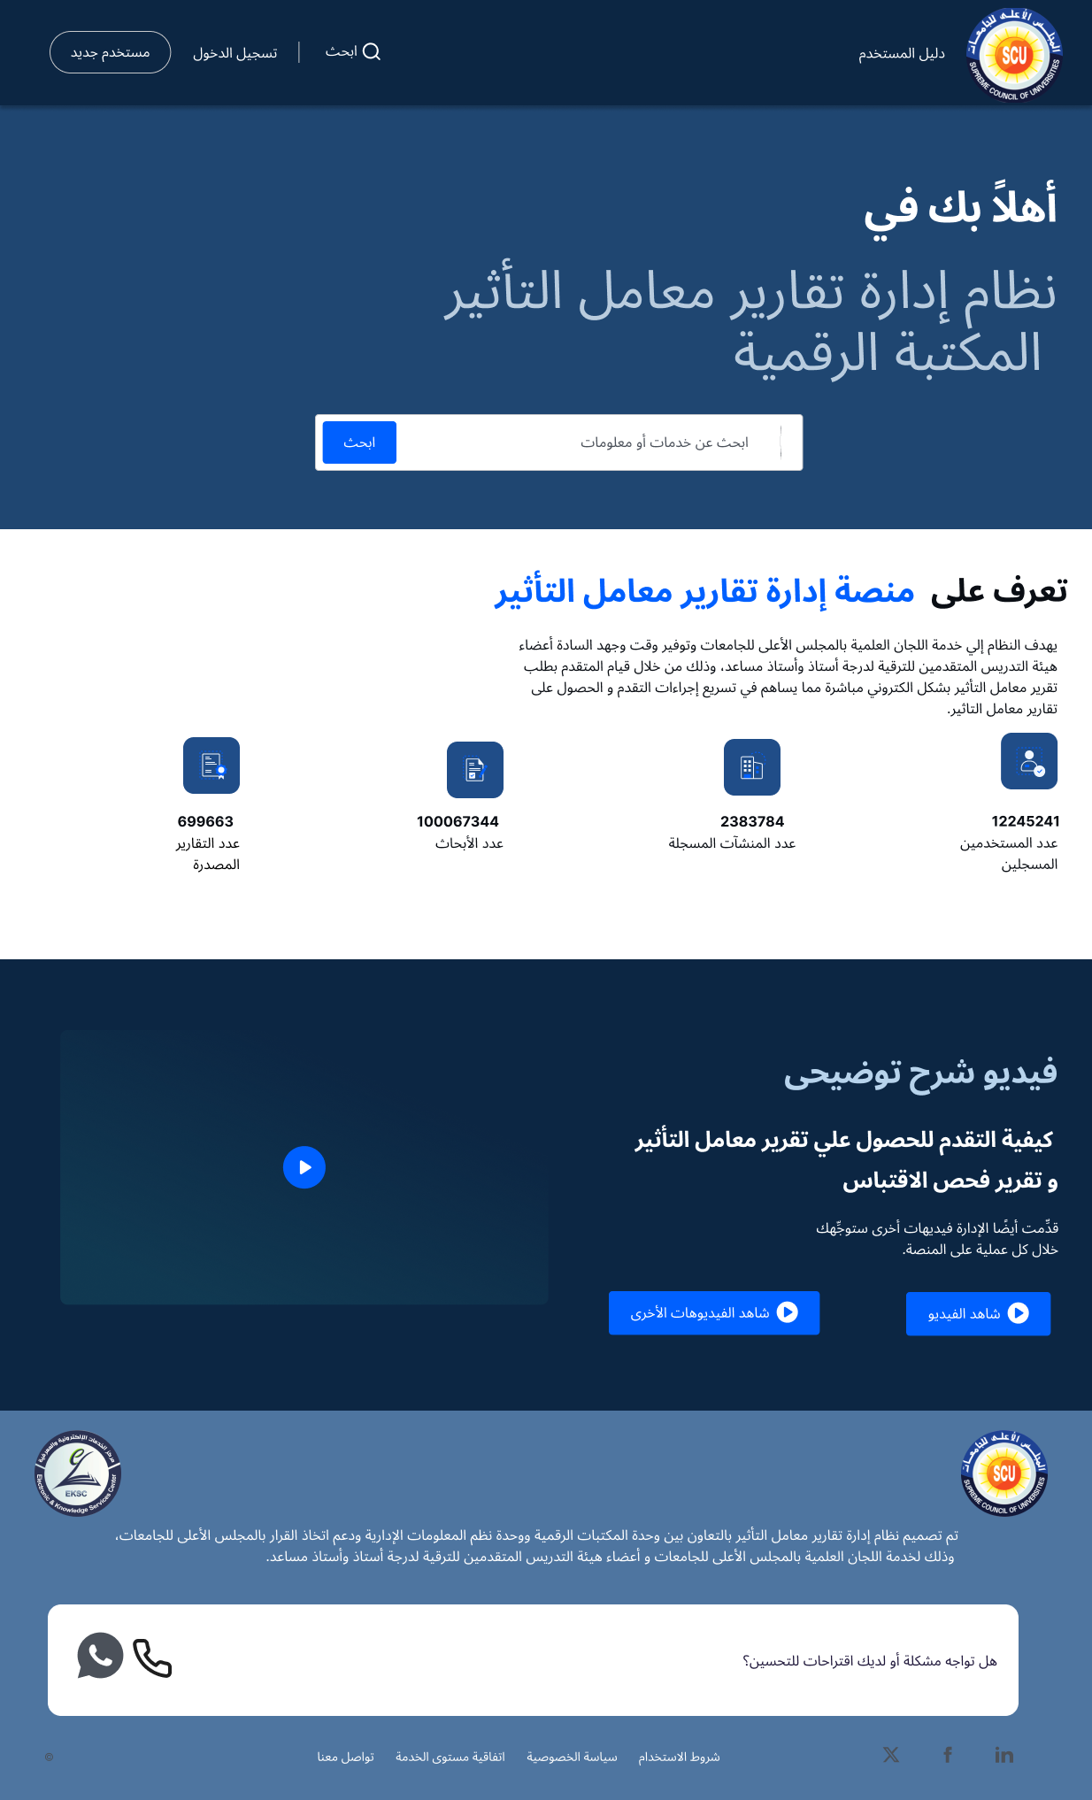
To Be - Home Page

Slide 16

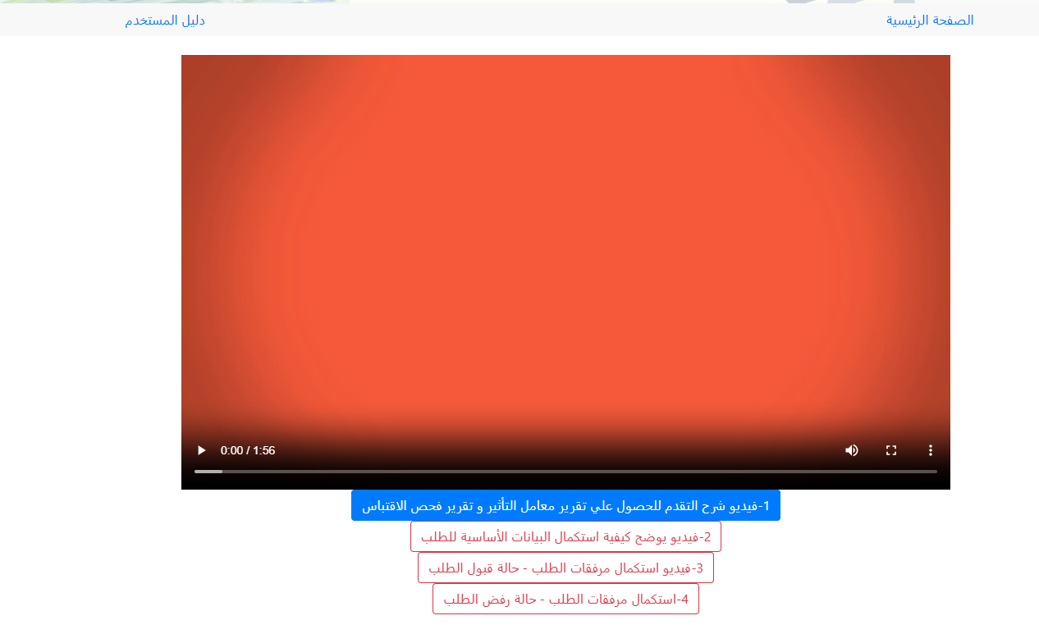
As Is – Guide
Very small text
Wrong place and design

Slide 17
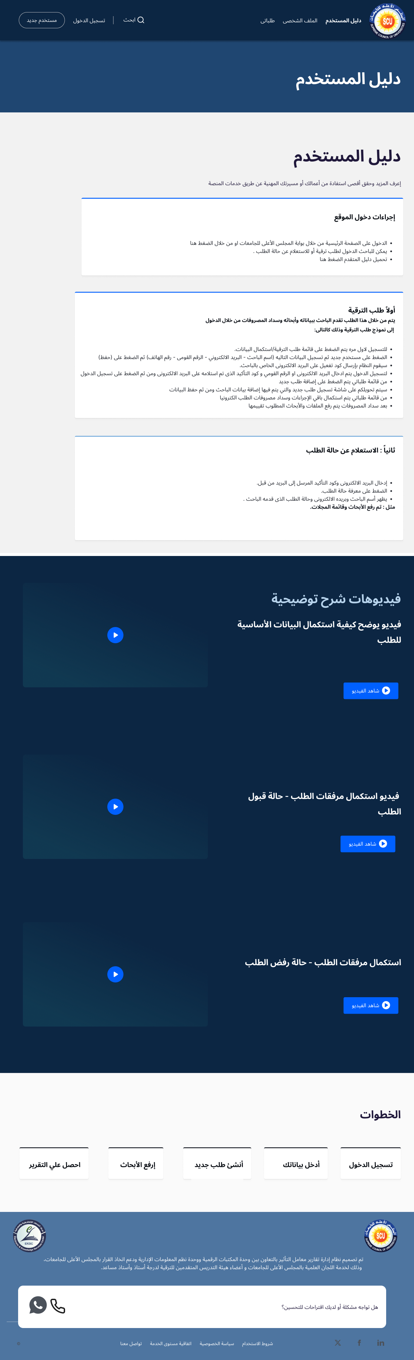
To Be – Guide

Slide 18
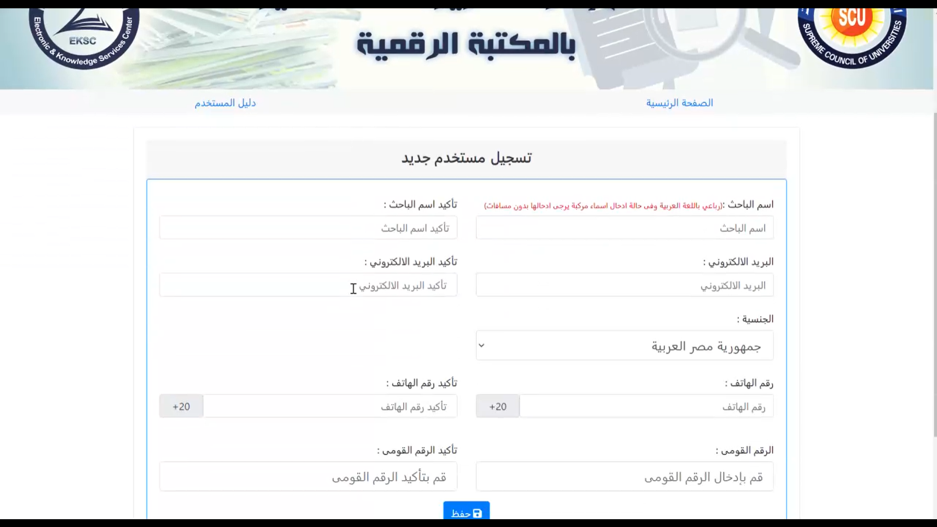
As Is – Personal info

Slide 19
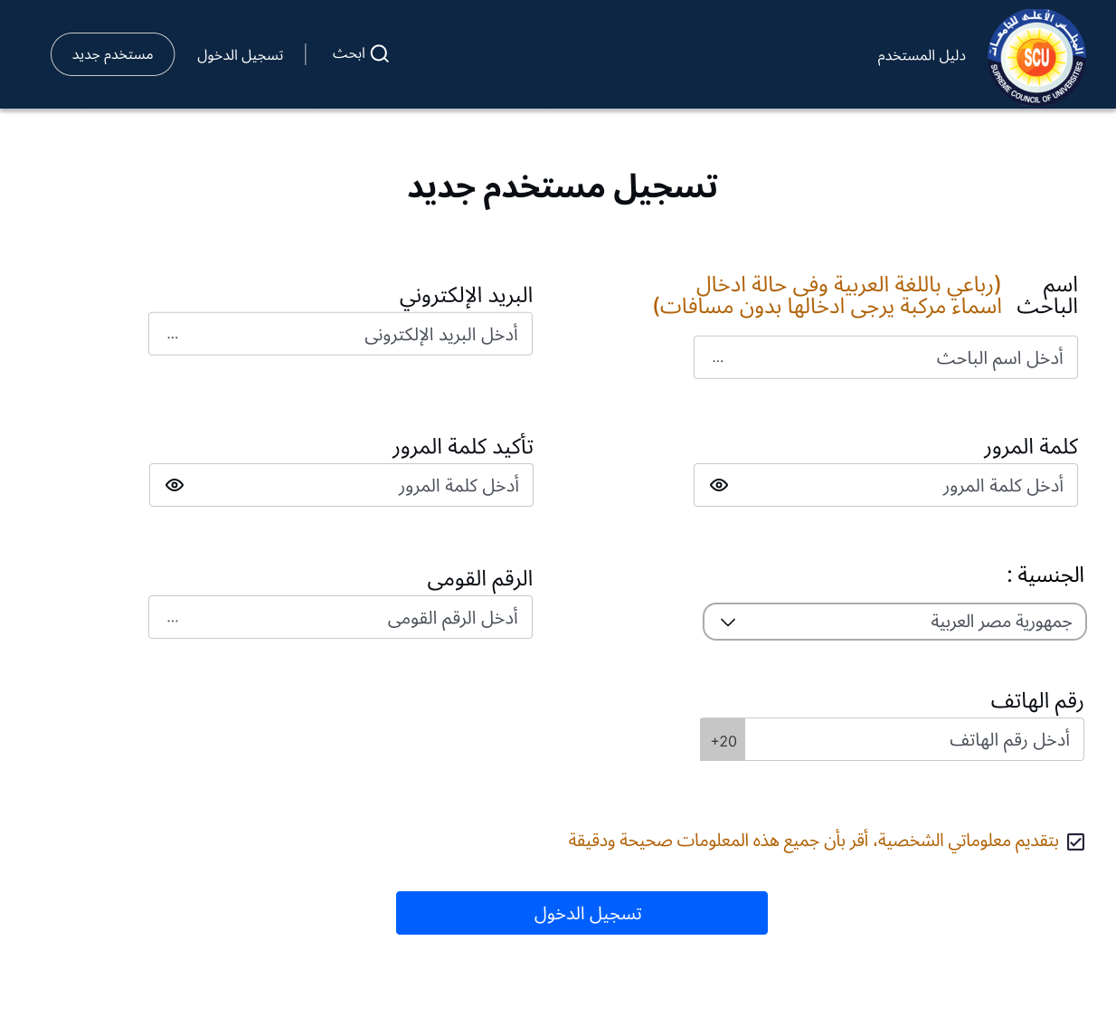
To Be – Personal info

Slide 20
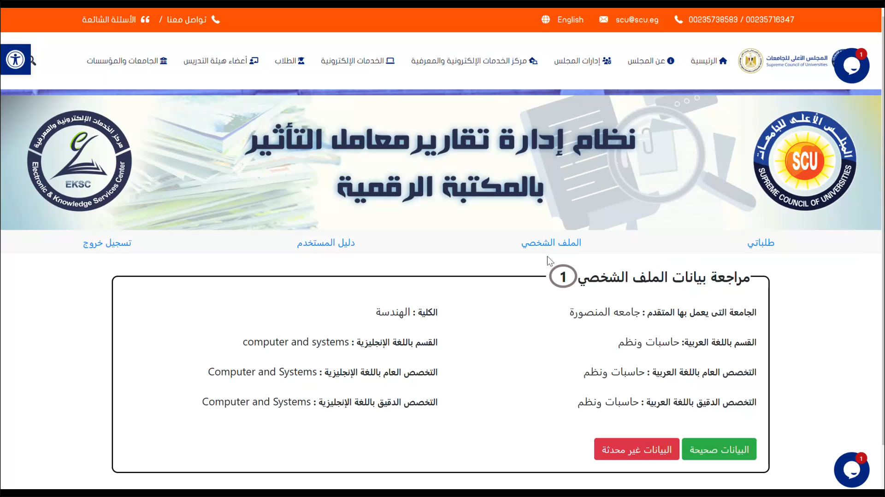
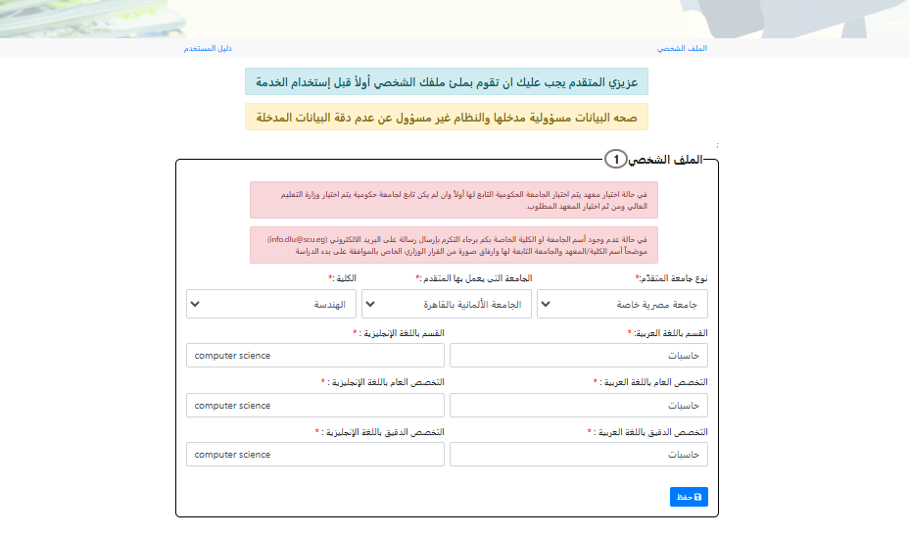
As Is – profile

Slide 21
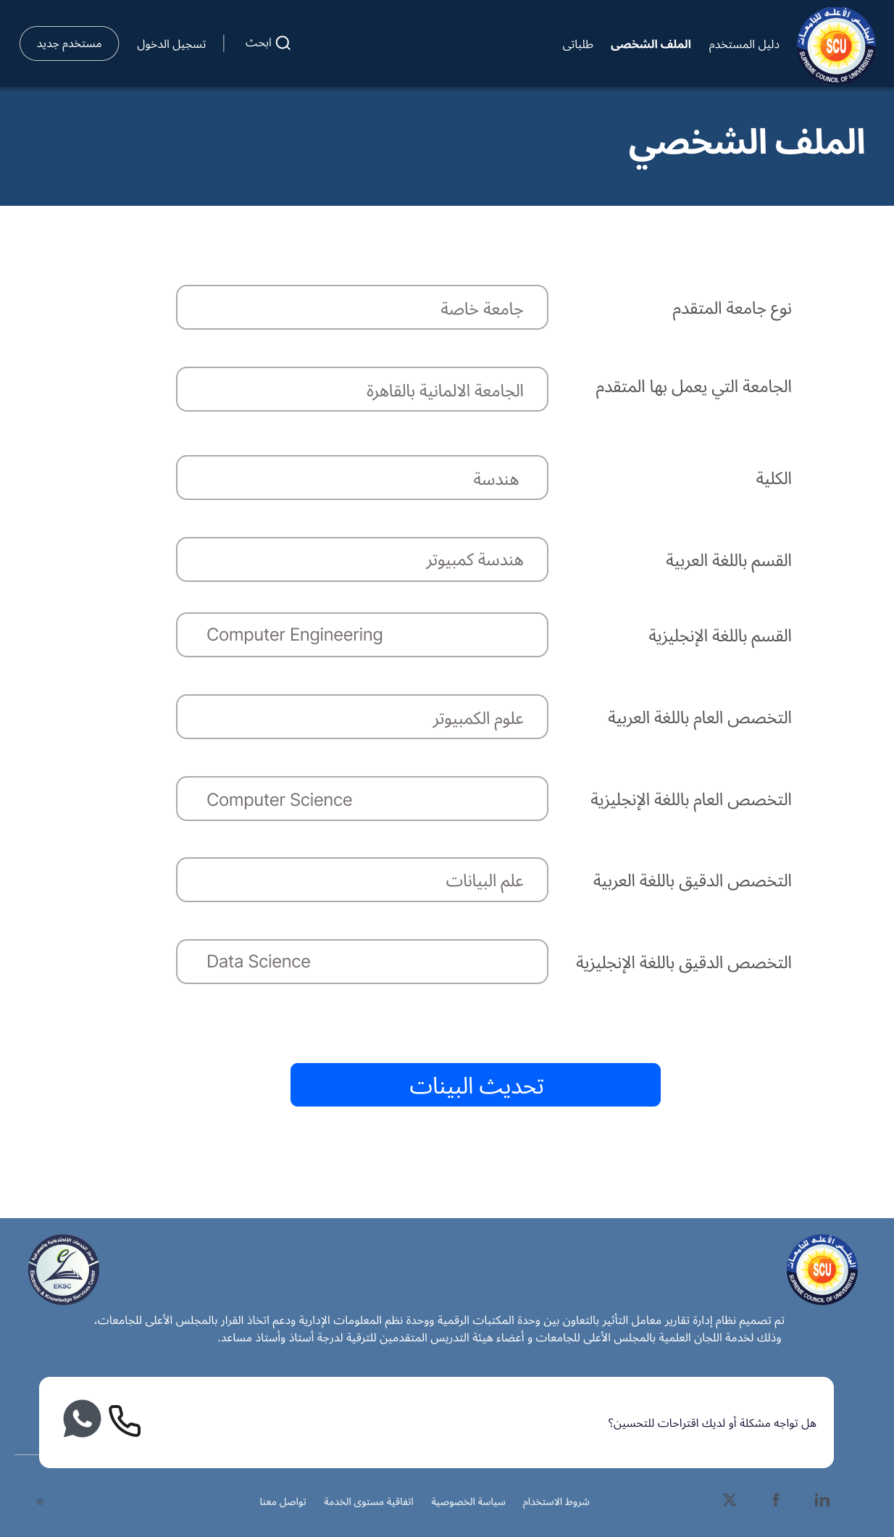
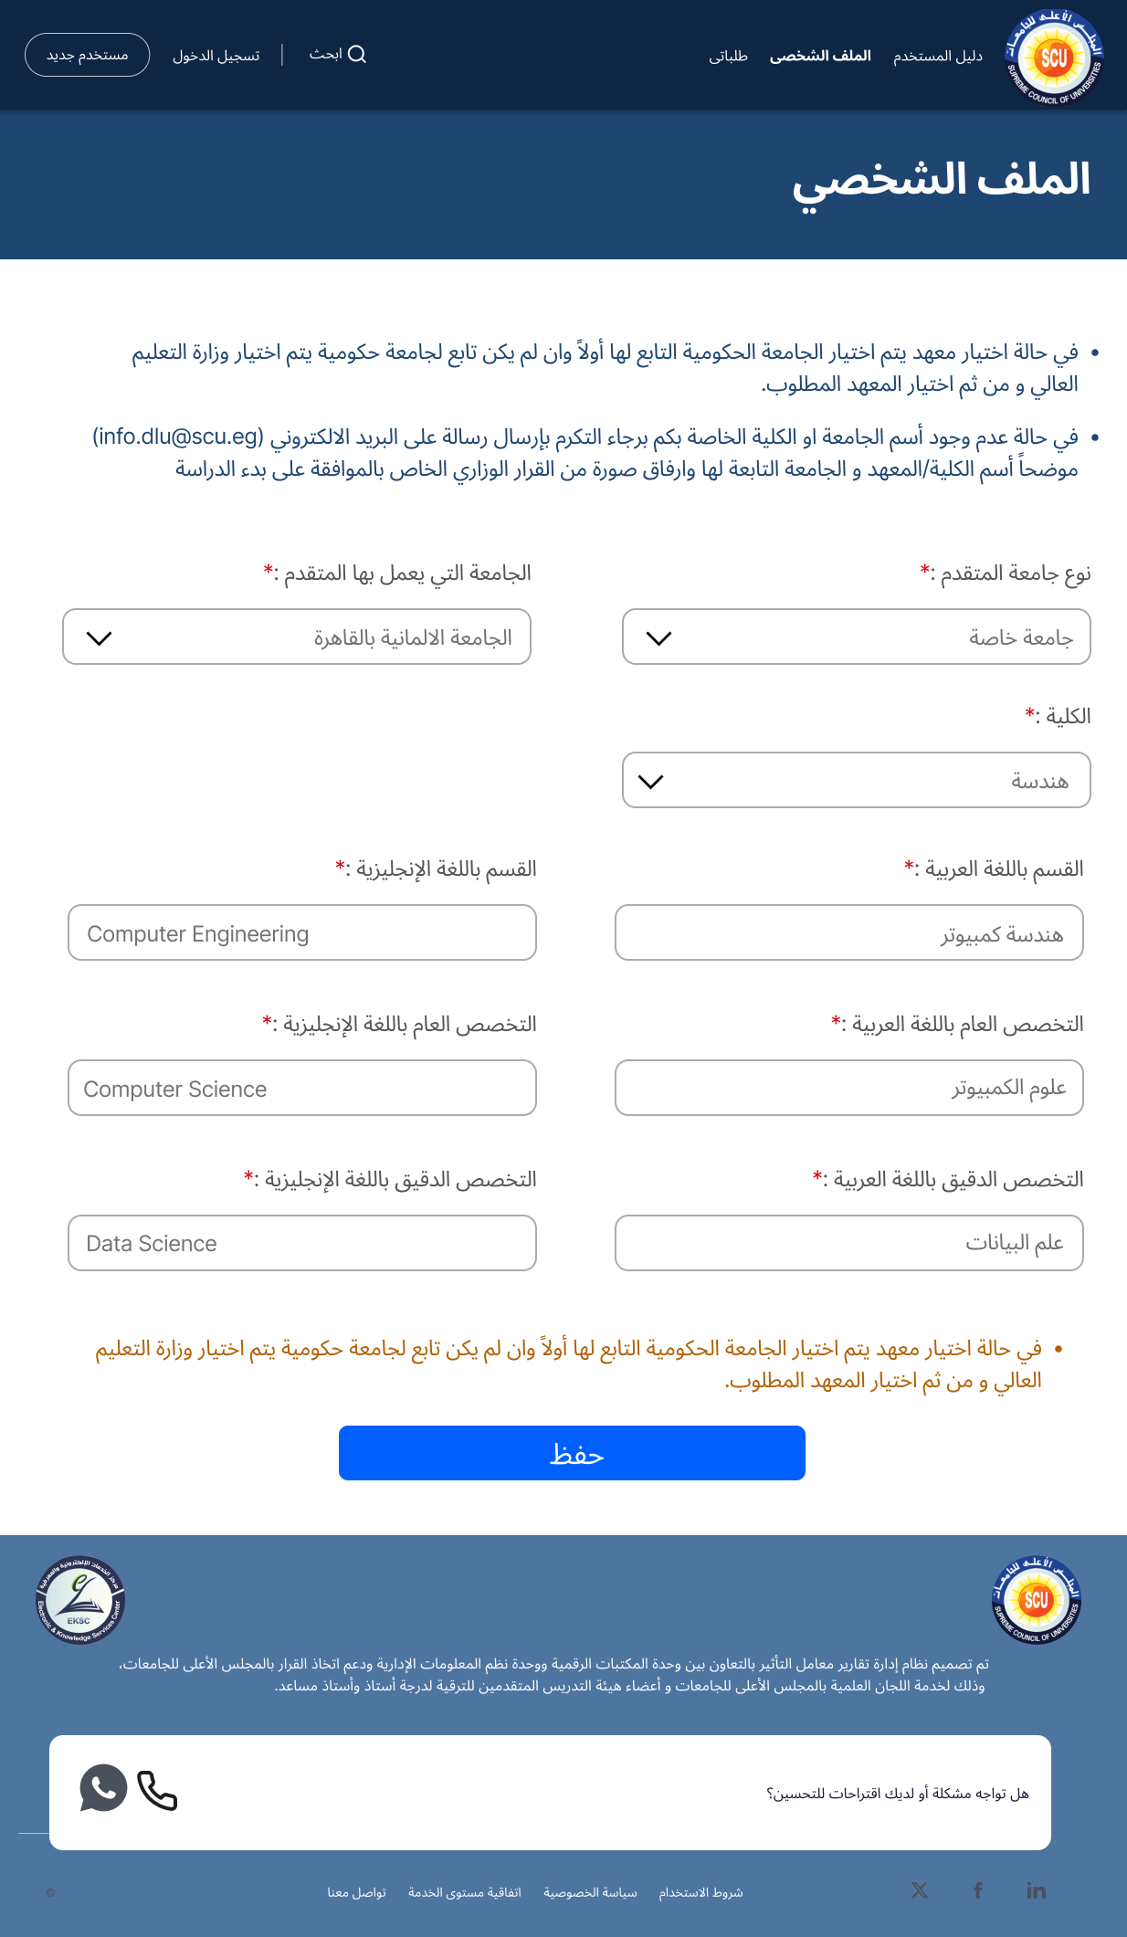
To be Profile

Slide 22
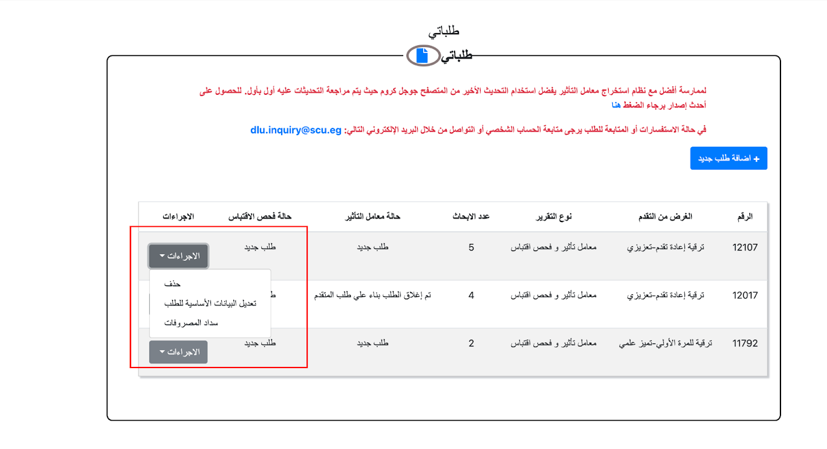
As Is Request options

Slide 23
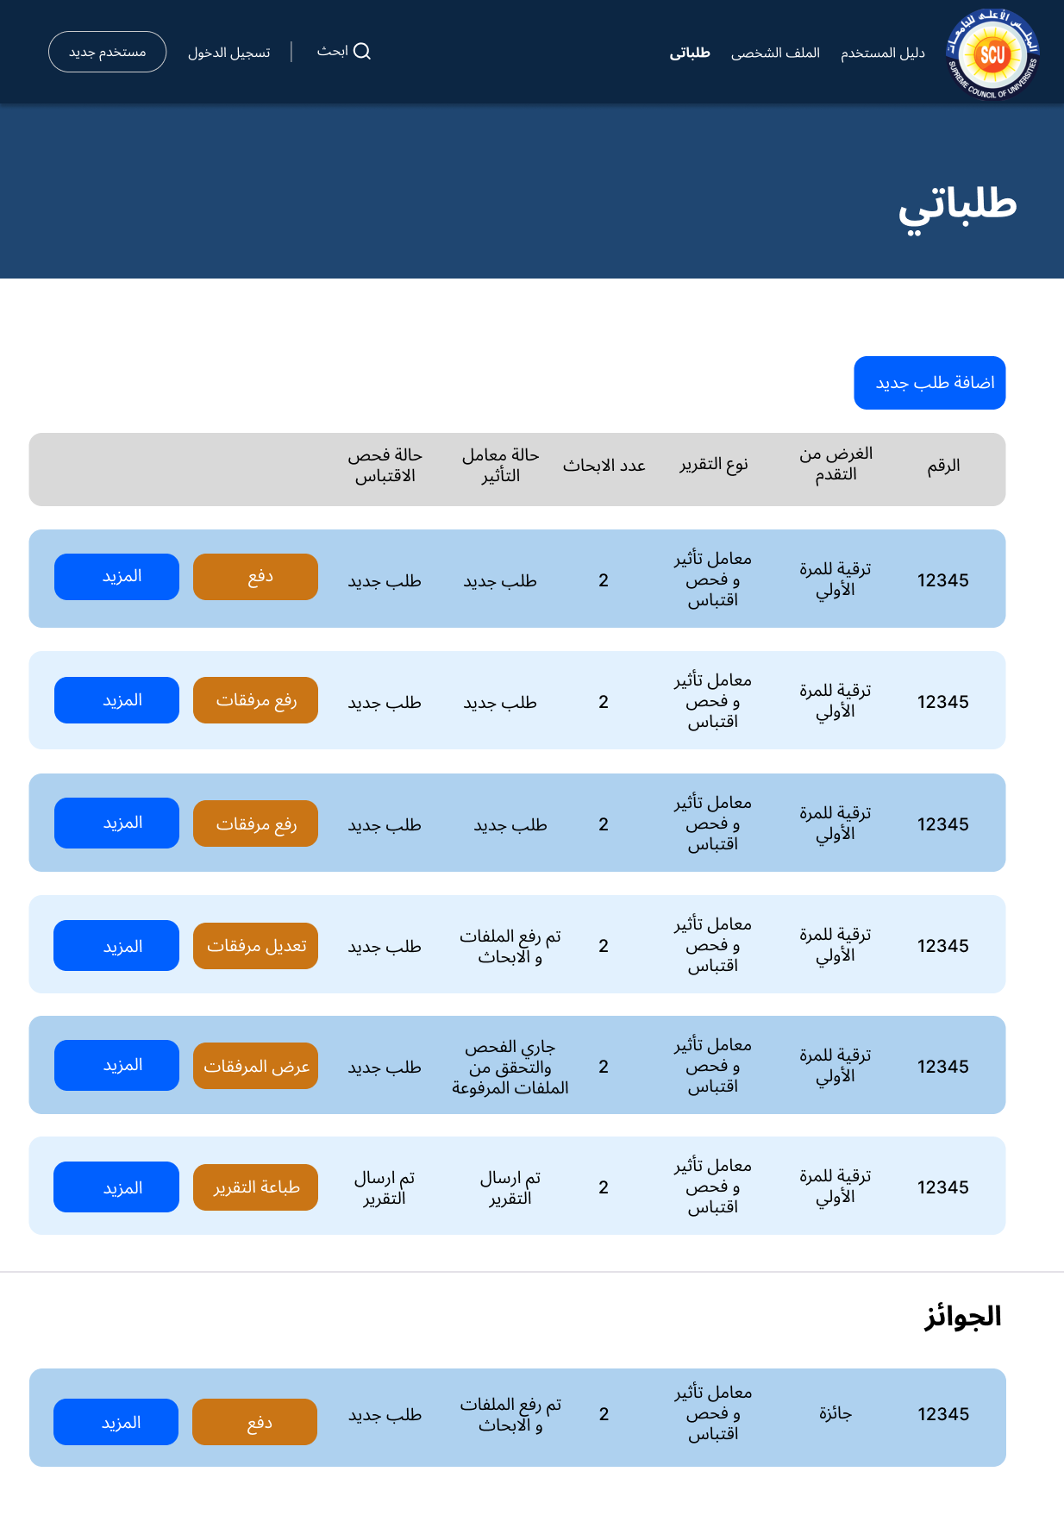
To Be – Request options

Slide 24
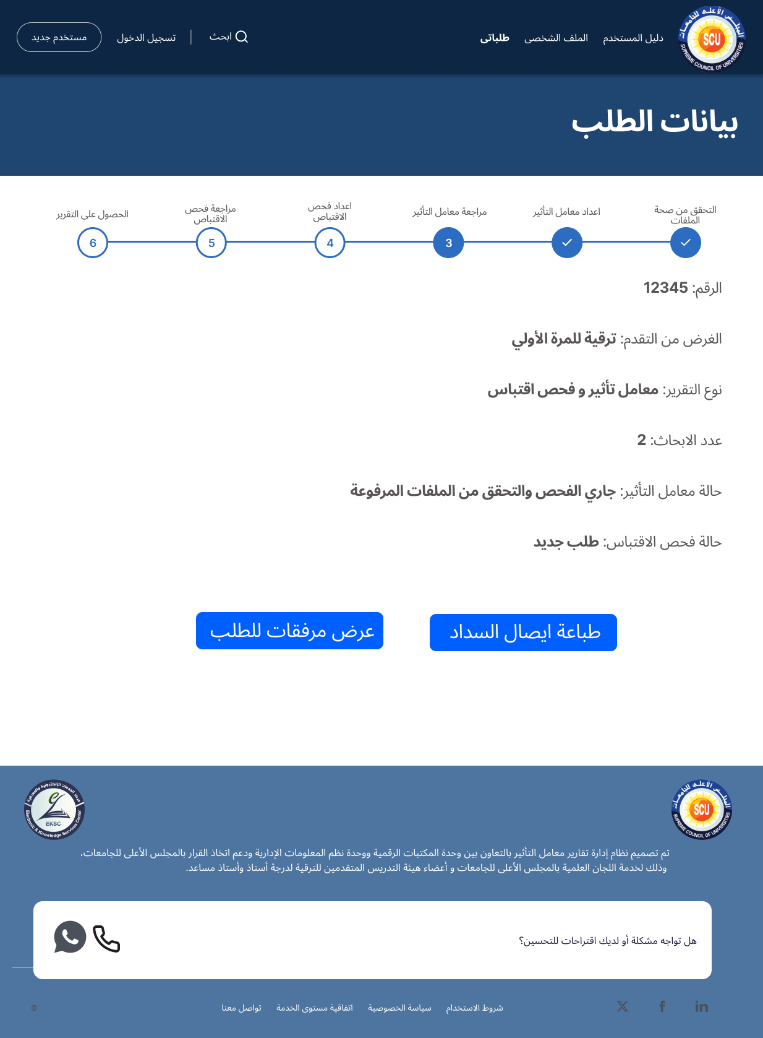
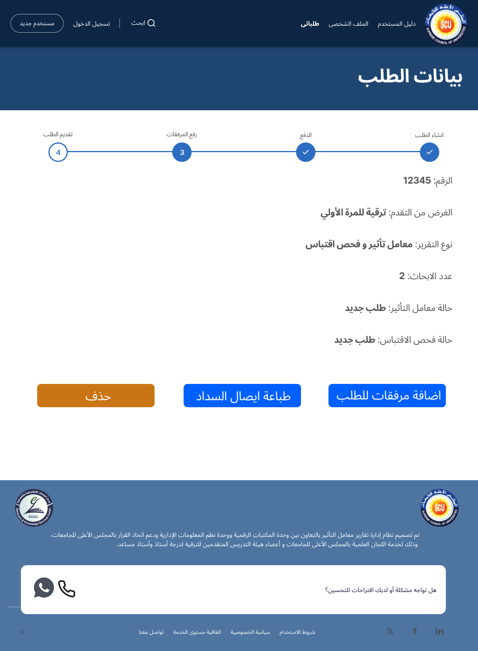
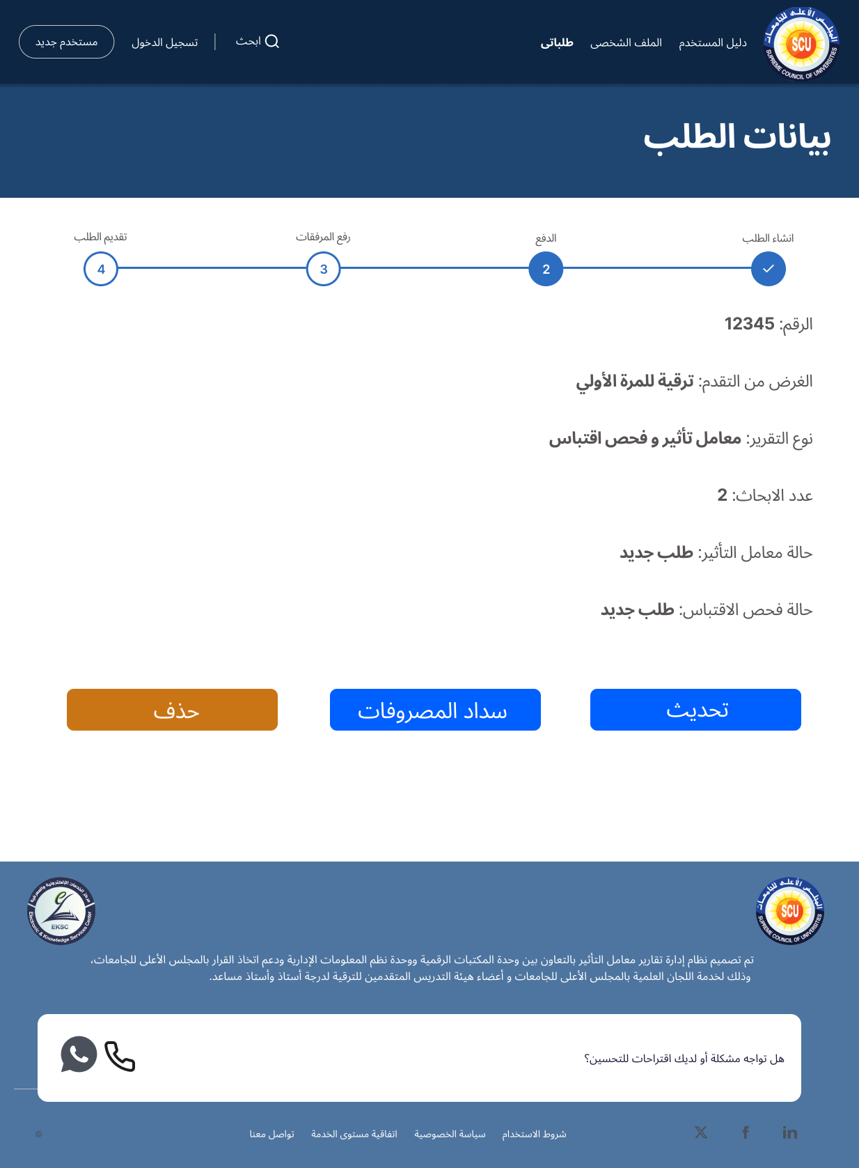
To Be – Request info

Slide 25
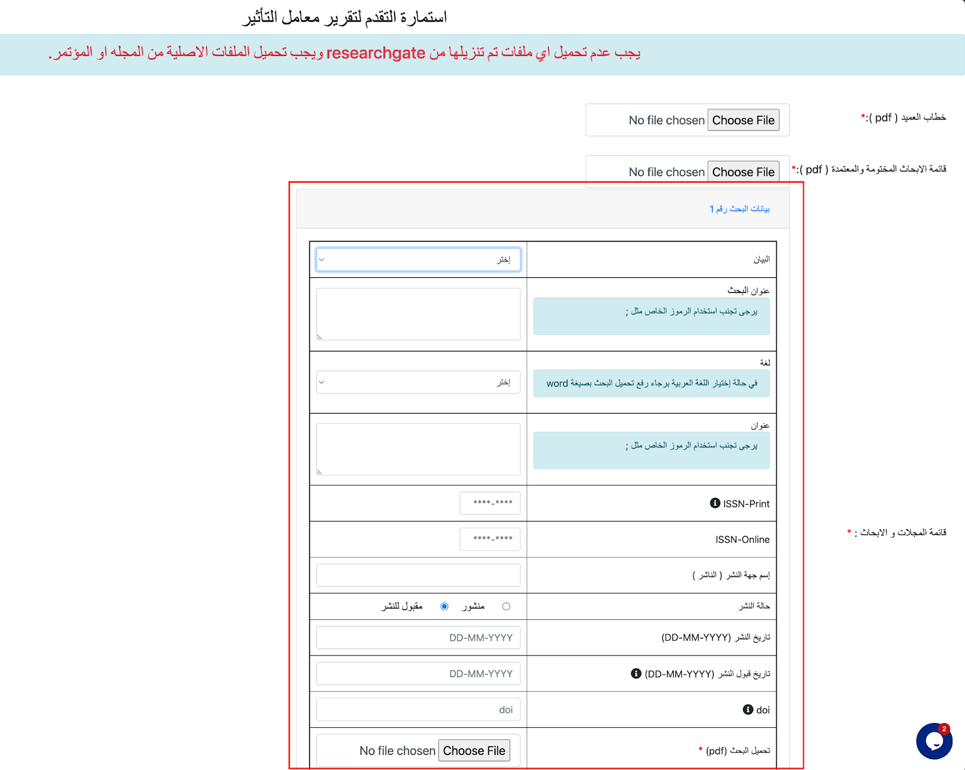
As Is - Papers

Slide 26
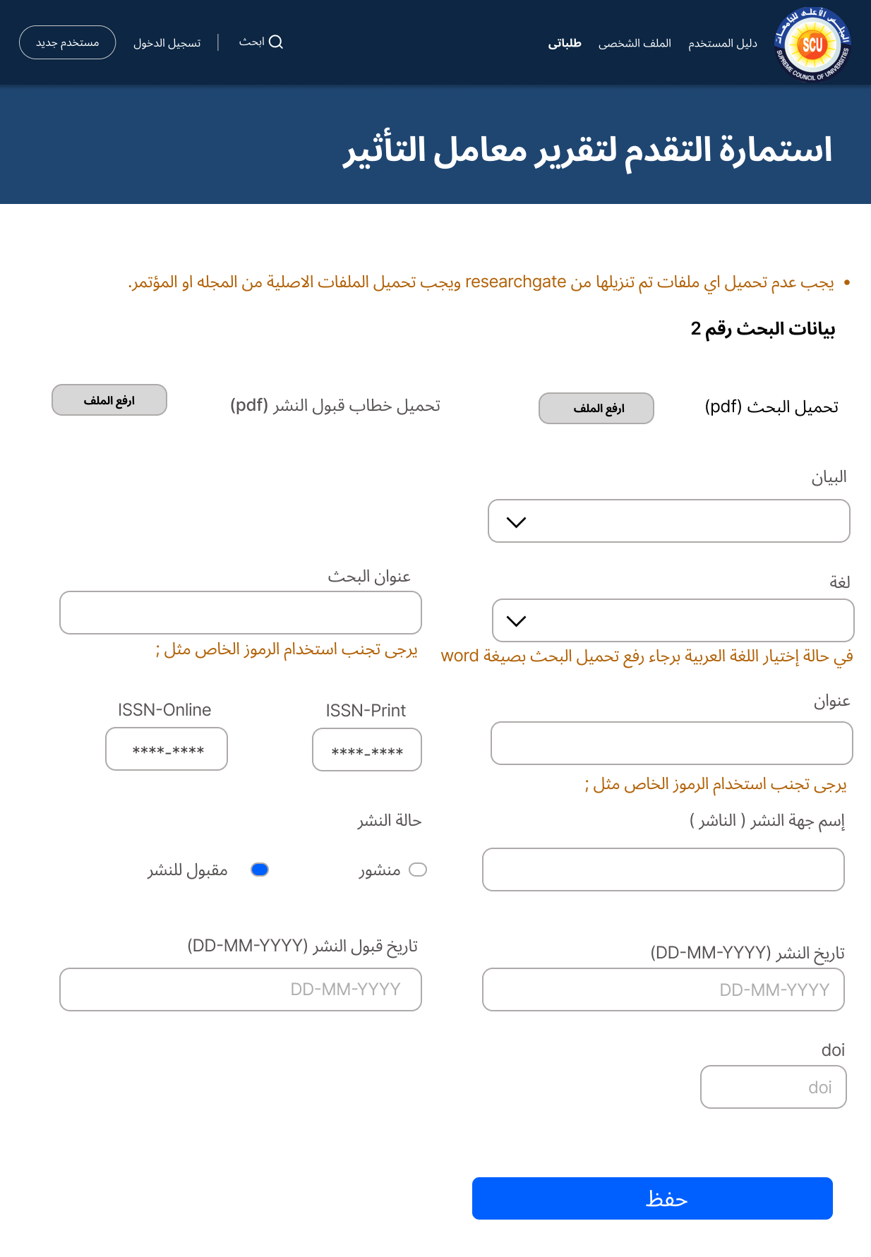
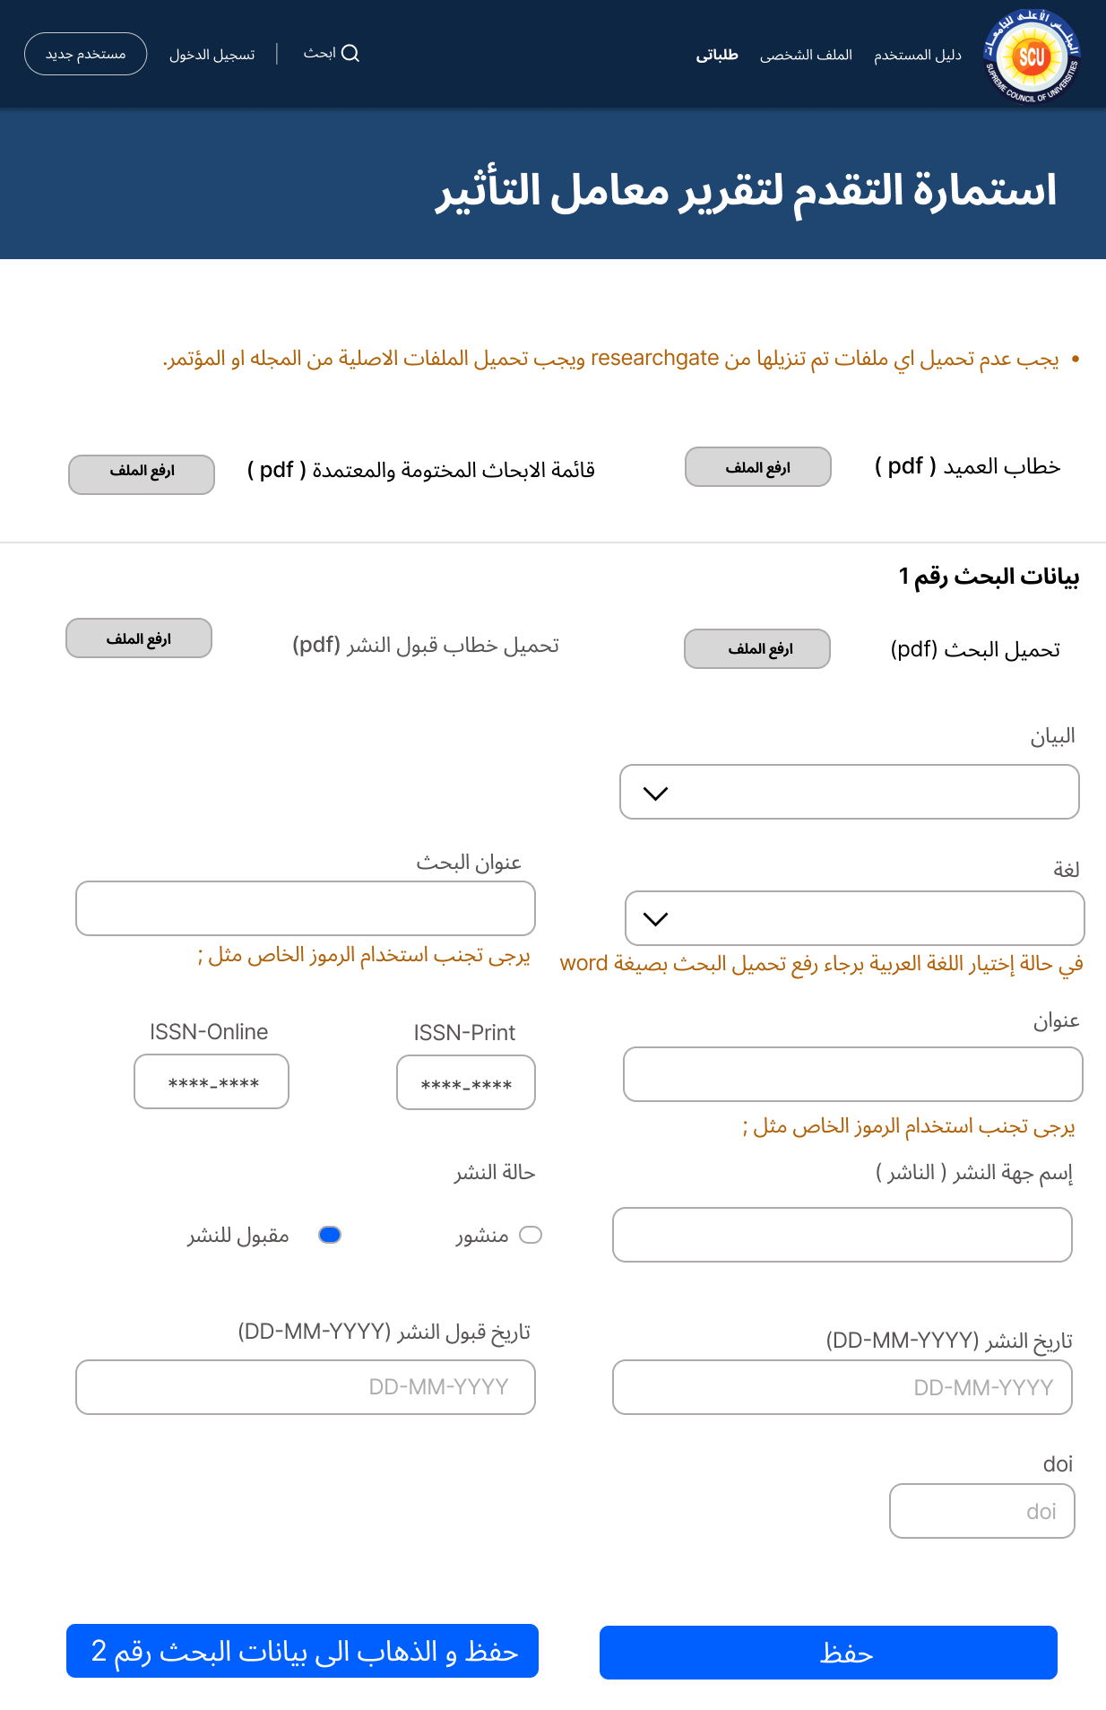
To Be - Papers

Slide 27

Added functionality

Slide 28
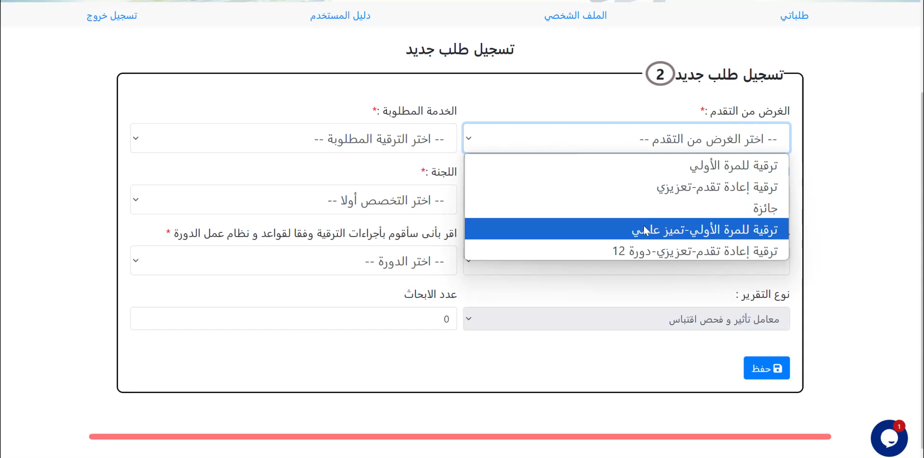
As Is – New Request

Slide 29
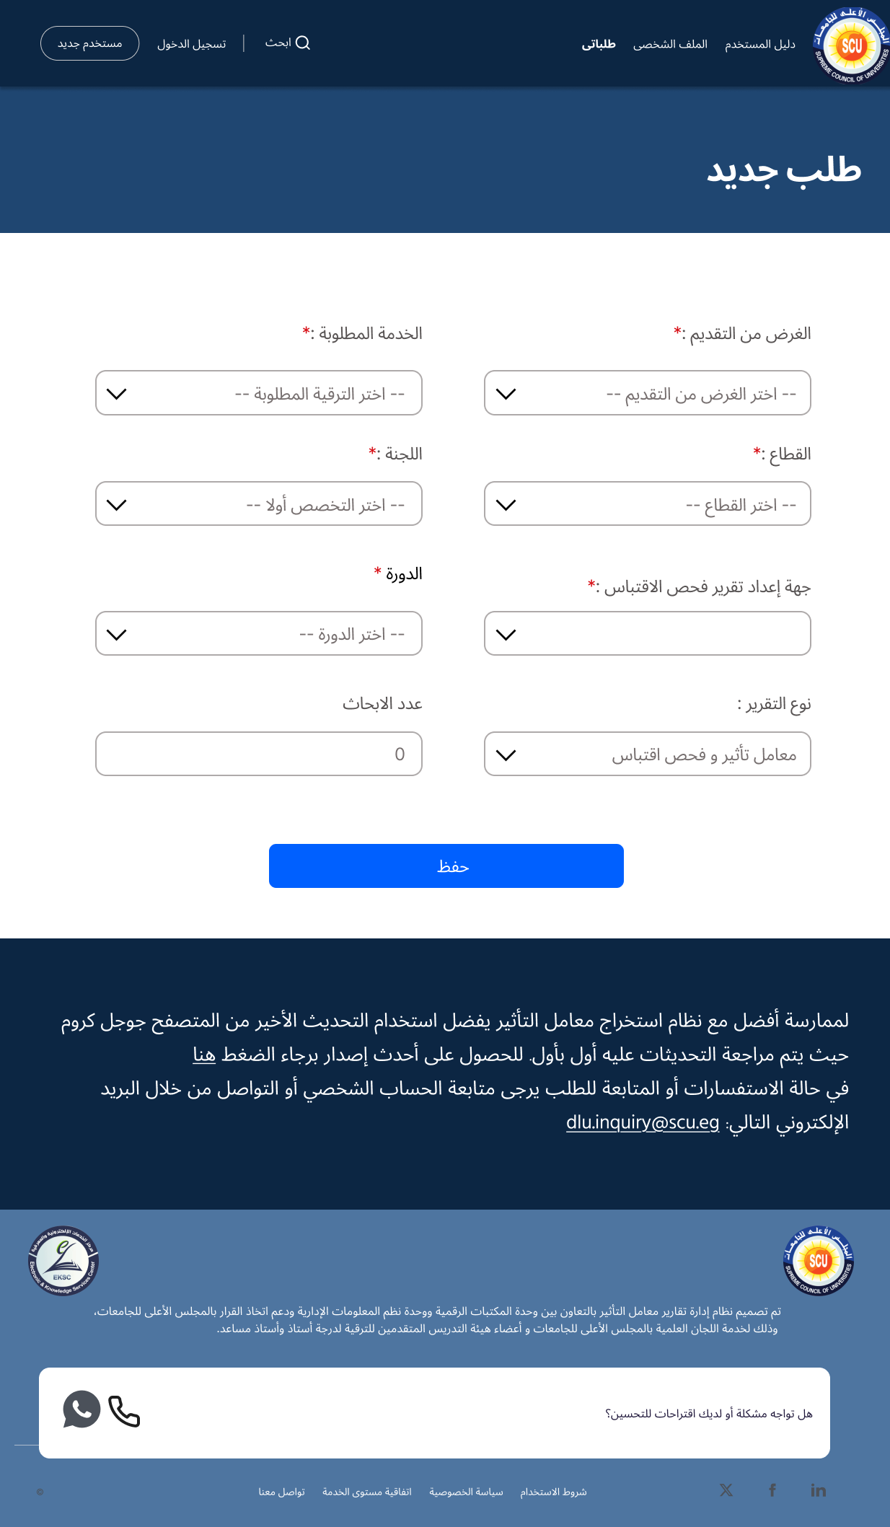
To be – new request

Slide 30
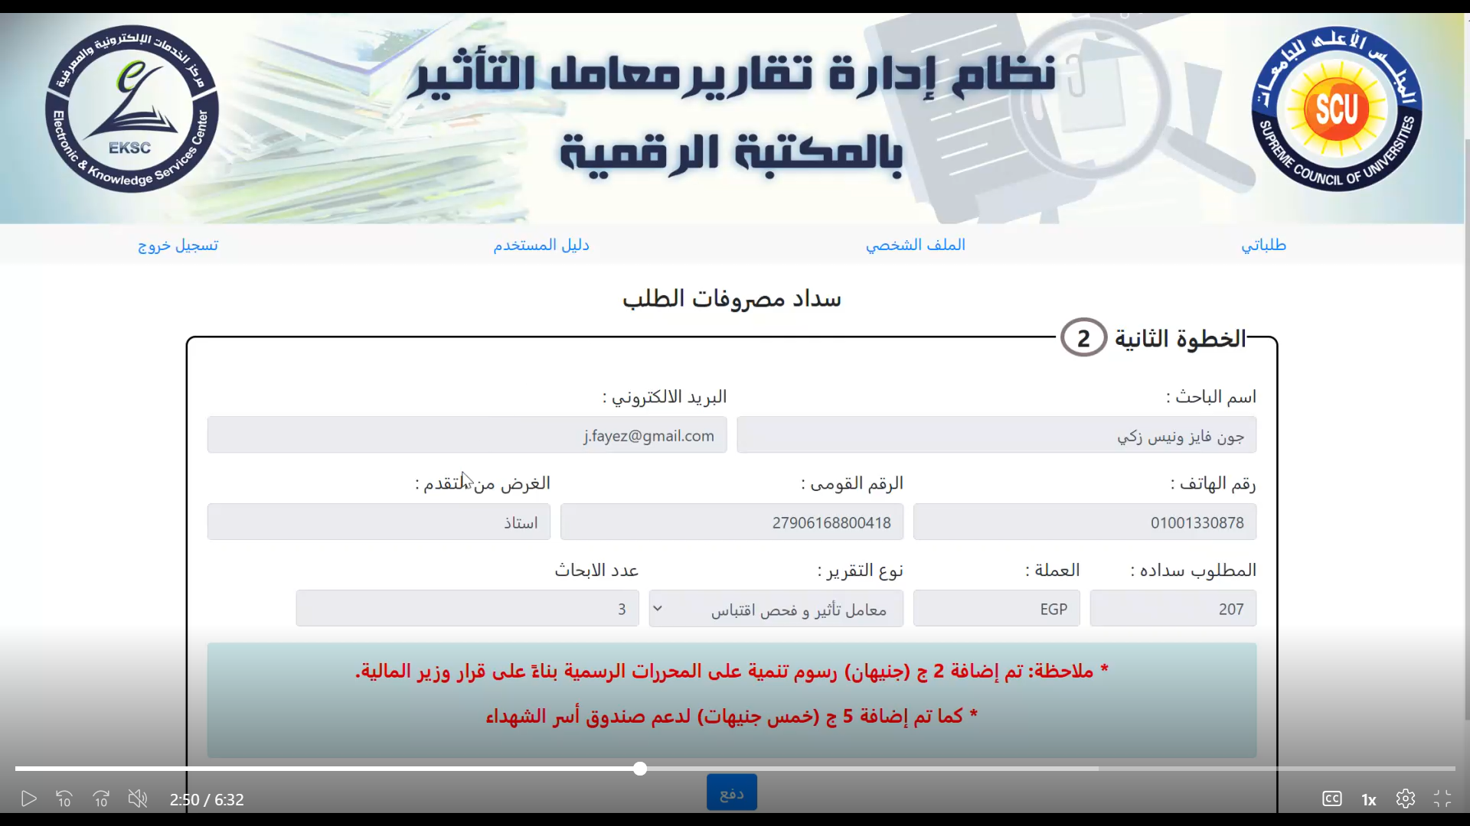
As Is - Payment

Slide 31
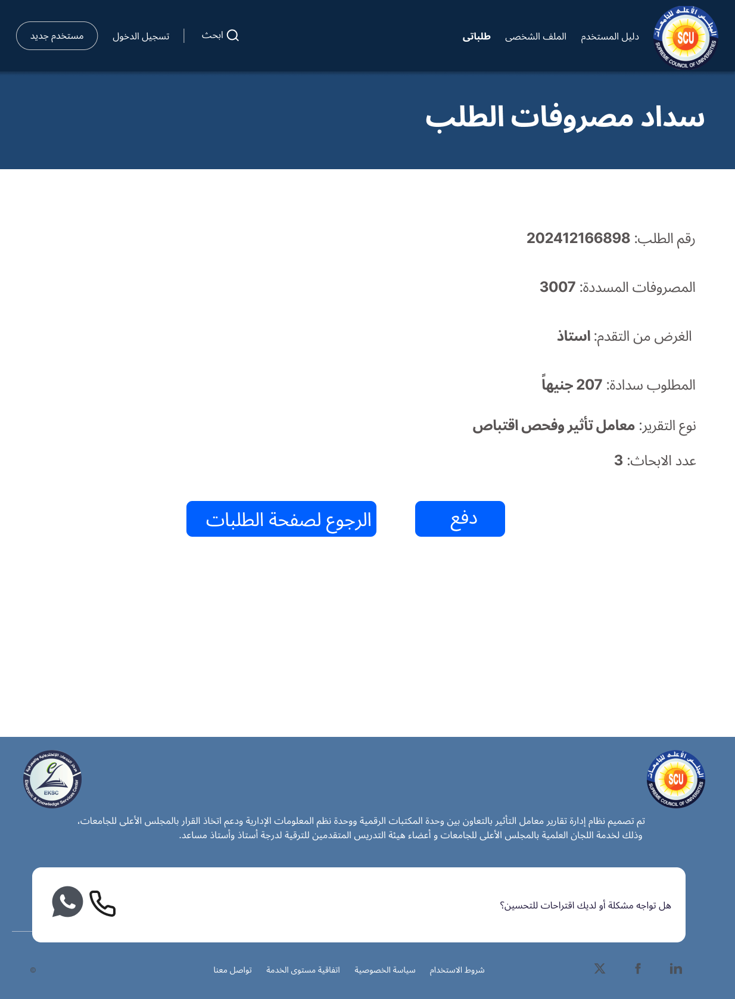
To Be - Payment

Slide 32
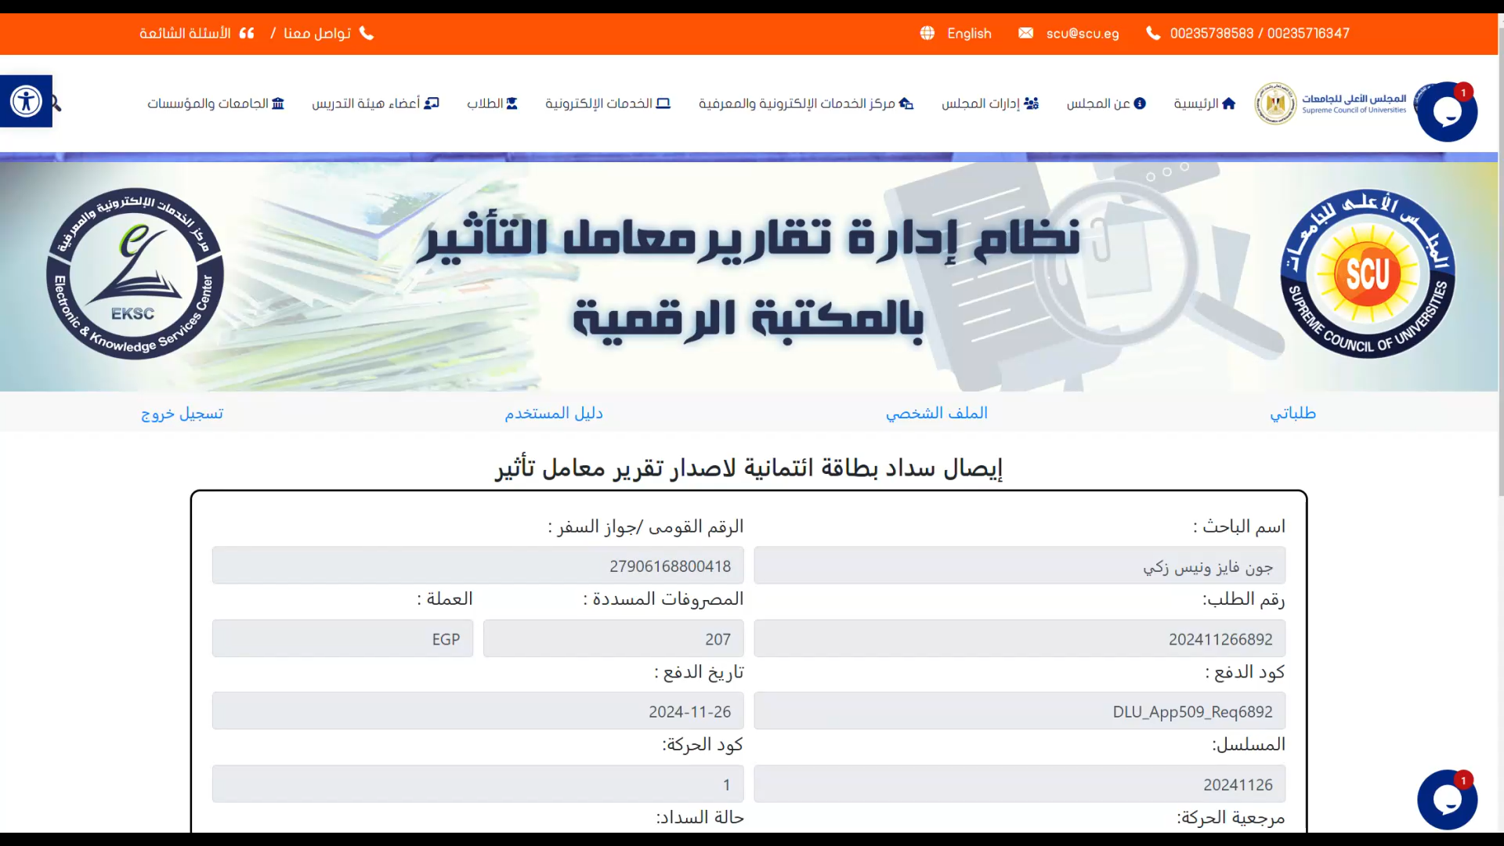
As Is – Receipt

Slide 33
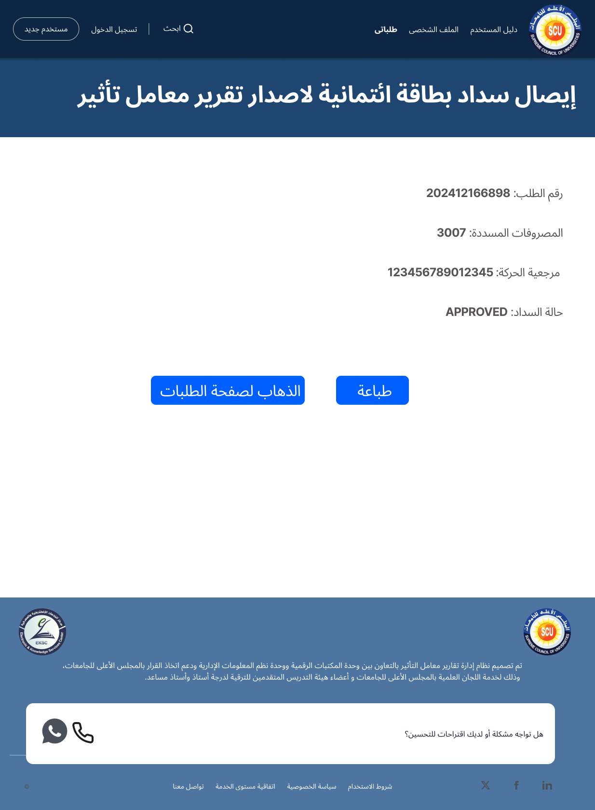
To Be – Receipt

Slide 34
More Features to address

Slide 35
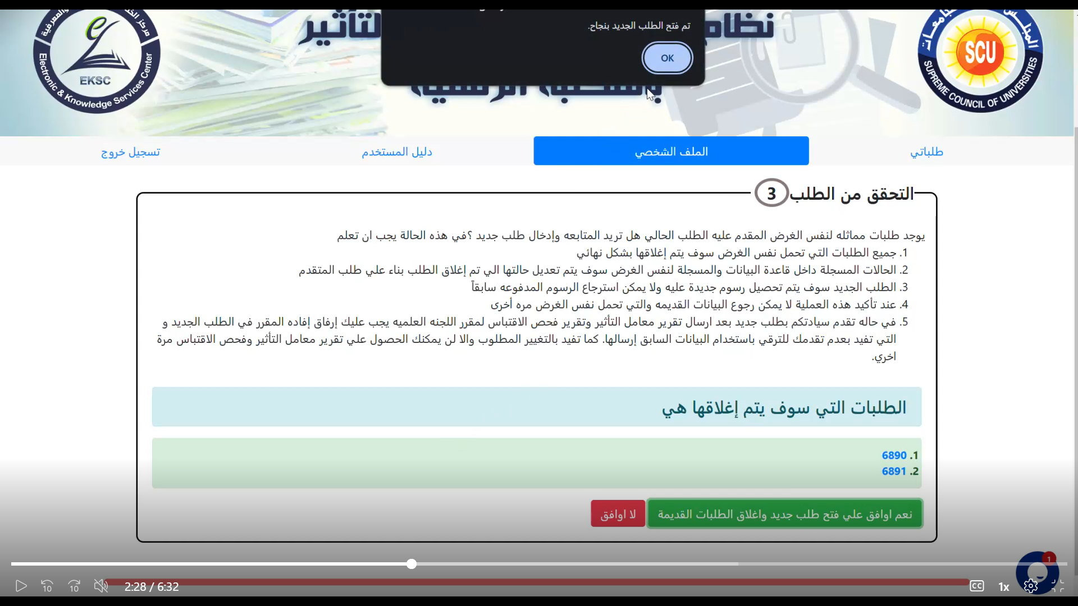
As Is
Removing the Alerts with bad design

Slide 36
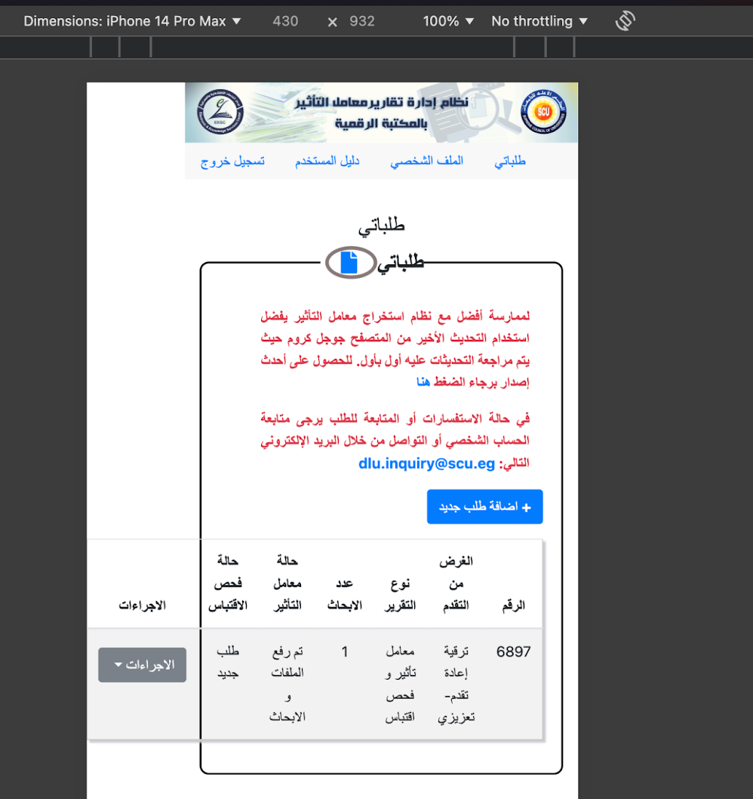
As Is
Make The Website More Responsive

Slide 37

Thanks!
Do you have any questions?

